Slide 1
Electronic integrated disease surveillance system (EIDSS)
BILL VAN DYKE
PRESIDENT
SPECIAL PROJECTS

Slide 2
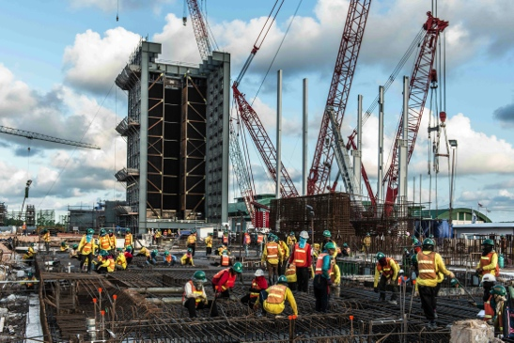
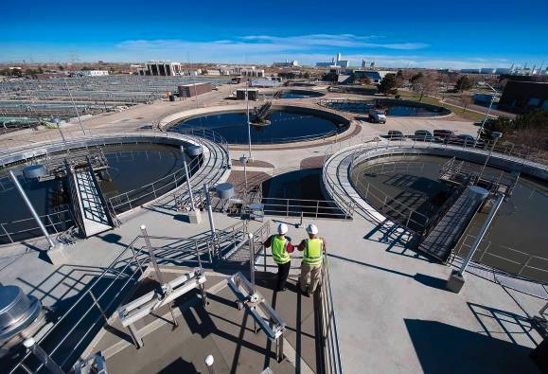
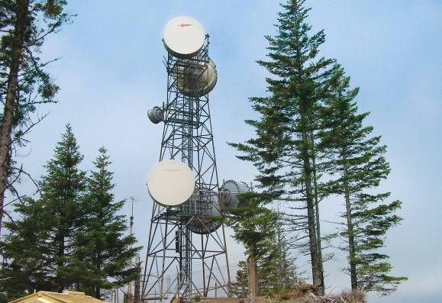
WE’RE BUILDING A WORLD OF DIFFERENCE. TOGETHER.
Founded in 1915
Global workforce of more than 10,000
Employee-owned corporation
$3.6 billion in annual revenues in 2013
More than 110 offices worldwide
Completed projects in more than 100 countries
Black & Veatch conducts 7,000+ active projects globally at any one time
Notes:
At Black & Veatch one of our competitive differentiators is our ability to draw from a global reach that includes a diverse mix of experts across geographies, business lines and services; using modern technology to enhance communication and collaboration is key to us creating value for our clients. Attracting, retaining and building a highly committed workforce also means that we leverage our employee ownership structure to improve performance, productivity, quality and engagement.
We do this by bringing the right talent, skills and applications to address local situations and by aligning our goals from our Board of Directors to our Executive Committee, Global Officers, Extended Leadership Team and professionals in a “cascading” fashion. The pay-off or end result is about investing in our future – creating a sustainable organization if you will – a sustainable organization built on its Core Values, that in our case that has been in existence since 1915, and is fully available and committed to fully supporting the goals of our clients.

Slide 3
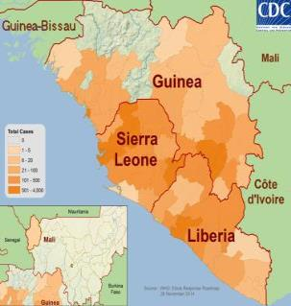
Electronic Integrated Disease Surveillance system
Enables timely response to disease outbreaks like Ebola
Provides near-real time information
Sustainable in resource constrained environment
Integrates with local health systems and language
2014 Ebola Outbreak in West Africa - Outbreak Distribution Map
EIDSS enhances rapid detection and response to outbreaks.

Slide 4
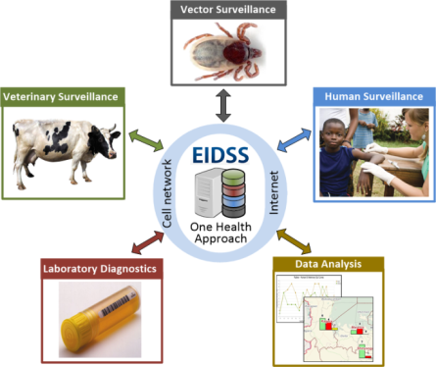
EIDSS Supports monitoring human and animal diseases in near real time
Strengthens disease monitoring and prevention by integrating with existing health systems.
Notes:
1) Vector Surveillance
- Vector Specific Data
- Linked Samples, Field Tests and Test Results
2) Human Surveillance
- Case-Based and Aggregate Reporting
Syndromic Surveillance
Urgent Notifications
Case Definitions and Investigations
Linked Samples and Test Results
3) Veterinary Surveillance
Case-Based and Aggregate Reporting
Passive and Active Surveillance
Linked Samples, Field Tests and Test Results
4) Laboratory Diagnostics
Samples, Aliquots and Derivatives
Barcodes
Test Assignments and Validations
Raw and Interpreted Disease Specific Test Results tracking
5) Data Analysis
Joint Analysis of Human, Veterinary and Vector Data
Aberration Detection
Basic Statistical Analysis
Standard & Ad-Hoc Reports
Time, Place and Person Analysis
Surveillance Indicators

Slide 5






Employs existing infrastructure and locally available equipment
Web Browsers
Handhelds
Internet,
Cellular Network
Tablets
EIDSS
Desktops
Available to countries as “open source.”

Slide 6
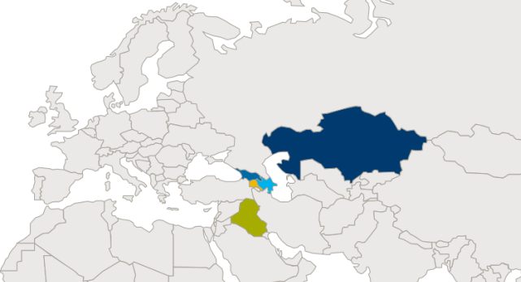
Deployment In Five Countries at 430+ sites
Georgia
Kazakhstan
Armenia
Iraq
Azerbaijan
National Surveillance System in Azerbaijan and Georgia.

Slide 7
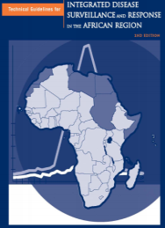
Developed with international partners
Developed with input of expertise from international partners
WHO, CDC, Water Reed (WRAIR), Armed Forces Health Surveillance Center (AFHSC)
Developed for DTRA
Integrates with other applications
WHO CISID, EPI Info, SAGES
Complies with international guidelines
WHO, 2010
EIDSS is an internationally accepted solution
Notes:
WRAIR - Walter Reed Army Institute for Research
AFHSC- Armed Forces Health Surveillance Center
WHO CISID Example background:
EIDSS supports electronic data transfer to WHO’ centralized information system for infectious diseases (CISID). Measles and Rubella disease reported to WHO CISID on monthly bases via EIDSS. 33 variables approved by local MOHs and WHO are transferred for mentioned diseases. Georgia started the electronic reporting in Dec 2013 and Azerbaijan - in Feb 2014. EIDSS is the only way these countries use to report Measles and Rubella case to WHO now.

Slide 8

EIDSS advances disease outbreak management
Enables rapid response to disease outbreaks
Sustainable in a resource constrained environment
Adaptable and scalable to country requirements
Mature solution in operation since 2005
Integrates with local health systems
Adaptable, Field-Tested Solution for Emerging Disease Response
Notes:
EIDSS closely matches WHO’s Technical Guidelines for Integrated Disease Surveillance and Response (IDSR) Strategy for resource-limited African region
Supports One World – One Health integration initiative (vertical programs, human, veterinary and laboratory sectors)
Supports IDSR information flow model with district being the focal point of data collection from different sources (hospitals, private NGO clinics, health facilities and the community)
Supports two way data communications from community level to central point and back
Support surveillance cycle: Notification-Investigation-Laboratory Confirmation-Final Classification-Response Measures

