Slide 1


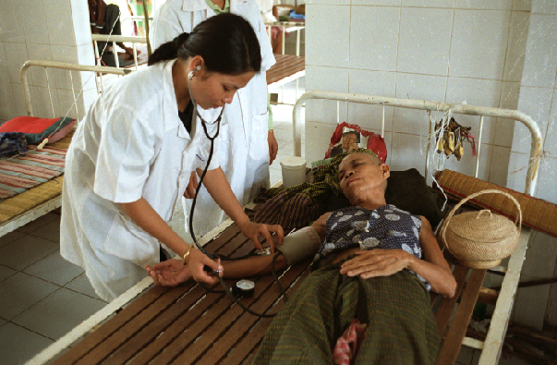
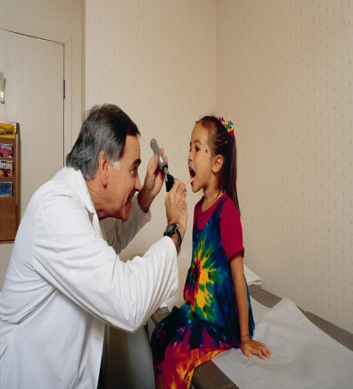

Cross River State
Hospital PPP Project
Corporate Council for Africa
Health and Infrastructure Working Group Breakfast Meeting
April 24, 2014
Bayo Oyewole,
Principal Operations Officer

Slide 2
IFC is a member of the World Bank Group
IBRD
International Bank for Reconstruction and Development
IDA
International Development Association
IFC
International Finance Corporation
MIGA
Multilateral Investment and Guarantee Agency
Est. 1945
Est. 1960
Est. 1956
Est. 1988
Role:
To promote institutional, legal and regulatory reform
Governments of member countries with per capita income between $1,025 and $6,055.
- Technical assistance
- Loans
- Policy Advice
To promote institutional, legal and regulatory reform
Governments of poorest countries with per capita income of less than $1,025
- Technical assistance
- Interest Free Loans
- Policy Advice
To promote private sector development
Private companies in 179 member countries
- Equity/Quasi-Equity
- Long-term Loans
- Risk Management
- Advisory Services
To reduce political investment risk
Foreign investors in member countries
- Political Risk Insurance
Clients:
Products:
Joint Mission: To reduce poverty and promote shared prosperity

Slide 3

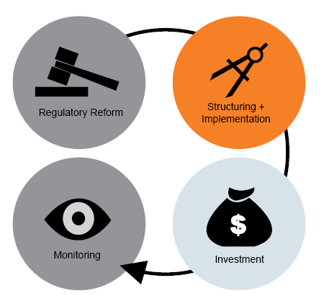
IFC and WBG Support for PPPs
Introducing competition
Setting the conditions for private investment
Advising governments
Collaborating with donors
Implementing PPP arrangements
Assessing consistency with environmental and social standards.
Tracking results and sharing lessons.
Financing projects through debt, equity and mobilization of external resources.

Slide 4
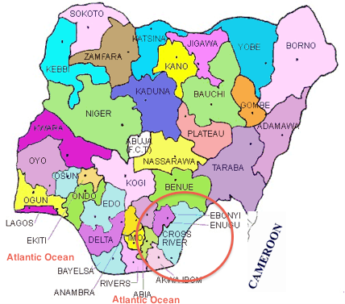
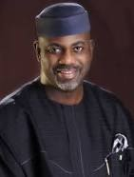
Cross River State
H.E. Governor Liyel Imoke

Slide 5
The Context
Hospital facilities in Cross River State are inadequate:
  Deteriorating infrastructure
  Shortage of skilled staff
  Lack of advanced medical equipment
  Sub-optimal quality of public health care services.
  Perception of poor quality leads to:
    Loss of confidence in the facilities
    Greater reliance on self-medication
    High rate of medical evacuation.
  Limited access to good high-risk obstetric care, ICUs and emergency/trauma care
  Shortage of doctors:
    Only 36 doctors and 938 nurses cover all the state’s secondary health facilities.
    Doctor-population ratio of 0.21 doctors per 10,000 patients -- one fifth of SSA average.

Slide 6
Business Development
Team
  Stefan Rajaonarivo (Dakar); Peter Gyergyay (Dakar); Peter Boere (Johannesburg); Jason Lee (Nairobi); Mambi Madzivire (Lagos); Bayo Oyewole (DC)
Identification and Promotion
  Personal contact results in Bayo visit to Calabar: June 2009
  Health PPP seminar in Johannesburg: March 4 2011
Preliminary Assessment
  IFC visit to Calabar to provide early confirmation of project viability: April 2011
Internal Approvals
  Concept Review Meeting (CRM): May 27, 2011
  Quality at Entry (QAE): July 5, 2011
  FASA Signing: Sept 19, 2011
Donor Funding (October 2011)
  HANSHEP (UK)
  NIPP (Netherlands)
  South Africa Trust Fund
Consultant Procurement (Nov 2011)
  Technical: PharmAccess (Dutch)
  Legal: Eversheds (UK); Aluko & Oyebode (Nigeria)
Kick-Off Mission (Feb 2012)

Slide 7
The Project
105-bed referral hospital to serve capital city, Calabar, and its environs.
Hospital will offer full spectrum of secondary healthcare services, including diagnostics (including MRI and CT), surgery, radiology, orthopedics, pediatrics, obstetrics, gynecology, neurology, etc.
Gateway Clinic to be included, offering primary healthcare services and referral mechanism for the hospital,
Equitable access for all CRS citizens through referral from primary public health centers and private facilities.
Every patient, public and private, is a paying patient. All patients pay out-of-pocket.
Government will subsidize clinical services to make them more affordable
IFC to help attract qualified private sector firms for design, construction, equipping & operation of hospital through transparent tender process.

Slide 8
Project Preparation (Phase 1)
Due Diligence
  Needs, Demand, Supply, Ability-to-Pay Assessment
  Legal Due Diligence
Investor Feedback
  Investor sounding
  US, India, Nigeria, South Africa, Middle East
Analysis of Options and Risks
Financial Model
  model includes baseline scenario and sensitivities based on lower or higher than expected demand,
  Based and on a variety of assumptions (macro, financing, clinical, revenue, operational cost, concession period)
Transaction Structure
  10-year project term
  Expected to be operational in 2015.
  Construction/equipment financed by government
  Private Operator responsible for operations
  Govt will own hospital; at end of concession period, project transferred to government.
  Hospital will be state referral hospital, providing quality and affordable access to clinical services.
  20 of 105 beds available for VIP patients
  CAPEX: approx $37m; OPEX: approx $2.4m

Slide 9

Payment Flows
Cashflows structured to provide balanced risk-sharing between CRSG and Private Partner
Fixed Payment (part of annual subsidy paid by CRSG to Private operator)
  Not subject to performance indicators;
  Prepaid in quarterly installments.
Availability Payment (part of annual subsidy paid by CRSG to Private Operator):
  Reflects management fee and willingness to absorb private patient demand risk.
  Availability Payment is a bid parameter to be provided in each Bidder’s submission.
  Prepaid in quarterly installments;
  Only cashflow subject to performance penalties.
Out of Pocket Payments –
  With some exceptions all patients admitted to the Hospital are required to pay out of pocket for medical service.
Revenue-Sharing Mechanism –
  In exchange for providing CAPEX CRSG receives quarterly revenue share that provides some upside.
Security package –Private Partner required to submit a performance bond during the construction phase and the operations phase – as required by law in CRS.
CROSS RIVER STATE
Fixed & Availability Payment
PRIVATE
PARTNER
Facility Management
and Clinical Services
Operational profit
Indigent Fund
Equipment Replacement Reserve
Revenue share
Out of Pocket Payments / Insurance
Patients

Slide 10
Tender Process (Phase 2)
Expressions of Interest (EOI)
  Advertisement (Nigeria, S. Africa, India and Economist)
  21 responses
  Teaser for respondents
Bidder Prequalification (RFQ)
  15 EOIs
  Evaluate EOIs
  5 prequalified: ICME (M. East), Lenmed (SA), Utopian (US), Healthshare (SA) Apollo (India) -- dropped out
Investor Due Diligence
  Data Room
  Draft Agreement
  Bidder Conference
  Comments on Draft Agreement
Request for Proposal (RFP)
  Tender Documents (PPP Agreement, Schedules, RFP Documents, Bid Criteria)
  2 bids submitted: Healthshare (South Africa); Utopian (US)
  Evaluation (Technical and Financial)
  Contract Award to UCL Consortium (includes Cure International, SIMED, Healthfore, Cuningham, ITB, CCP)
Bid Negotiations
  Complete documentation
  Tie up loose ends
Project Closing
  June 24, 2013

Slide 11
Expected Post-Tender Results
The hospital is expected to provide high quality advanced secondary clinical and diagnostic services to the citizens of Cross River State, particularly for the 500,000 citizens of the greater Calabar area.
The hospital is expected to have 6,000 admissions and 60,000 out-patient visits a year.
The hospital will play a role in the government’s overall growth strategy for the state by creating jobs.
The project will encourage private investment in the health care sector across the country to complement scarce public resources.
Health professionals in the state will build expertise through exposure to international best practice.
Nigeria and surrounding countries will refer to this model for good practice in concession contracting under international PPP standards.

Slide 12
Lessons Learned
Political
  Electoral timetable is important
  Legal environment for PPPs is prerequisite; legal due diligence is key
  High-level government commitment
  Strong champion with Governor’s ear is crucial
Manage consultants strategically;
  Write very clear and watertight TORs
  There is not a lot of global experience in Health PPPs
Geographically dispersed team can present difficulties;
  Manage conference calls and team visits strategically
  Consider meeting in the middle where possible
Challenging environment,
  Few experienced bidders; some may need handholding
  May need to adapt model to environment
Processes can be unwieldy
  Be strategic and navigate internal processes smartly to avoid delays
  Follow processes in parallel where possible

Slide 14
